Slide 1
Calendar App
Team 5
Alex Lundin, Anhquan Nguyen, Brain Bell, Reed CUmmings

Slide 2
GitHub Demo (2 min)
Commits
Code Frequency
Meeting Template

Slide 3
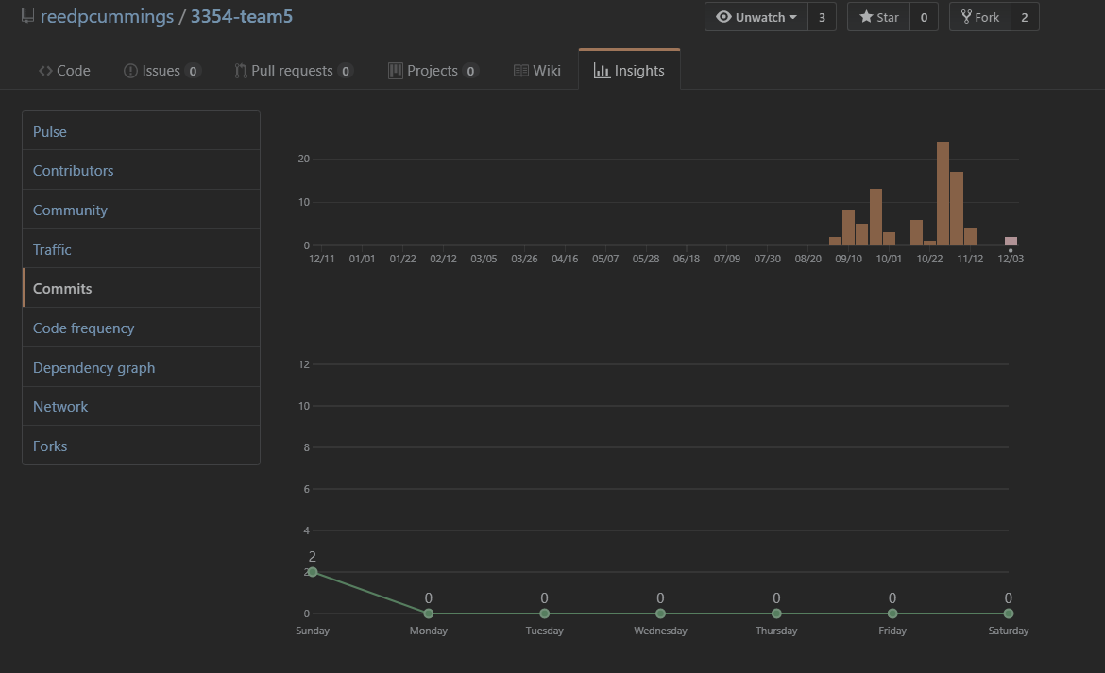
GitHub Demo (2 min)
Commits

Slide 4
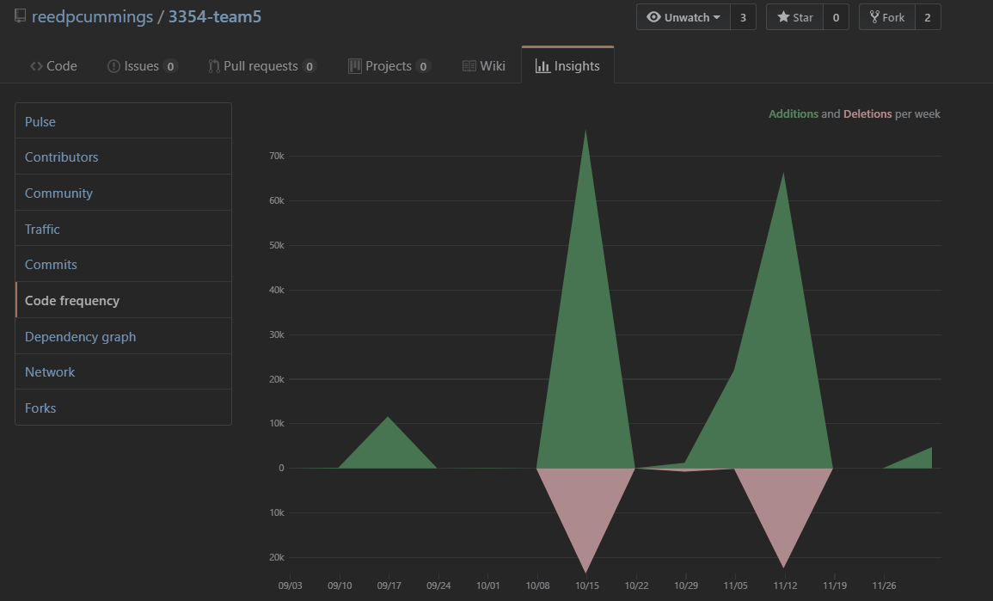
GitHub Demo (2 min)
Code frequency

Slide 5
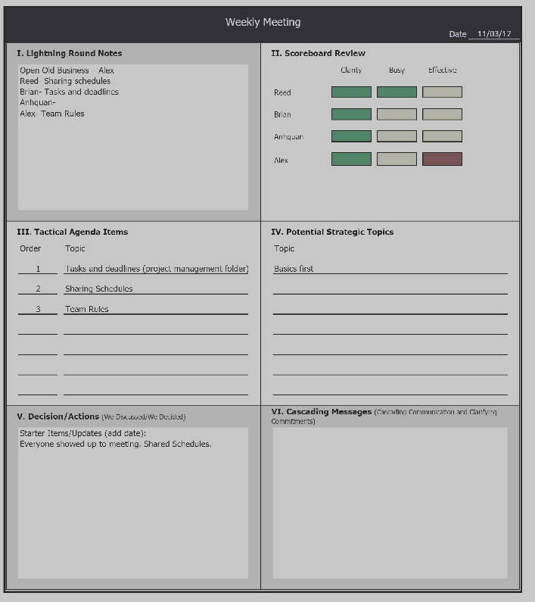
SCRUM Template

Slide 6
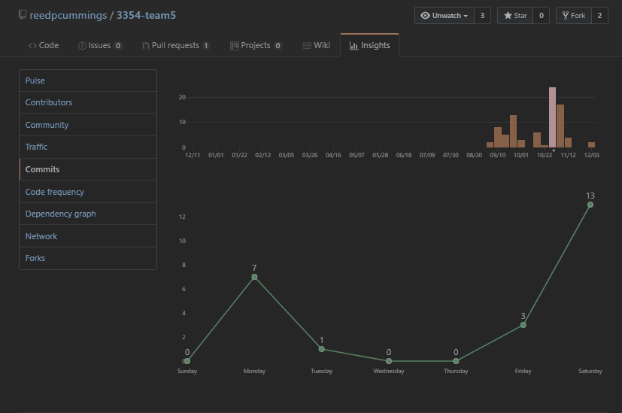
GitHub Demo (2 min)
SCRUM effectiveness

Slide 7
Team Organization (1 min)
Team meetings
SCRUM
Online
Offline
GroupMe
Outlook
Task distribution
Started with the original spec

Slide 9
Team Organization (1 min)
Team meetings
How often your team meet during the semester?
What are the common ways your team members communicate with each other?
Task distribution
How do you decide which team member(s) take on which task(s)?
or do you always work on the same task together (e.g., pair programming)?

Slide 10
Coding Style
No meaningless variable or method names
ex) calling a variable x
No generally named methods
ex) public void do()
Mostly used full words instead of abbreviations
DB is one exception because that is a field wide abbreviation
Proper naming techniques
ex) addEvent

Slide 11
Comments
Generally use block comments with scattered in-line comments
Natural Language in comments so everyone can understand them
No meaningless comments

Slide 12
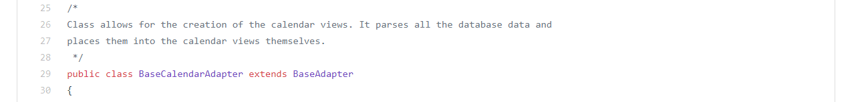
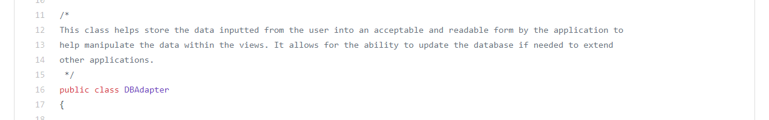
BaseCalendarAdapter
DBAdapter

Slide 13
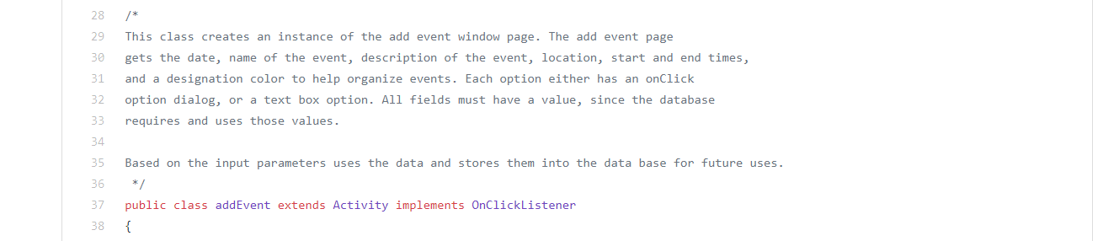
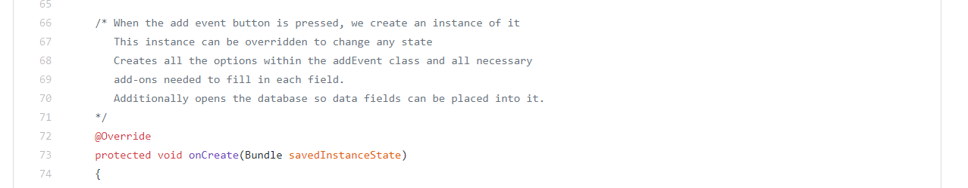
addEvent
onCreate method

Slide 14
Design Pattern (1 min)
Model-View-Controller Architecture
Good for heavy GUI applications such as a calendar
Good for multiple perspectives
Ex) Daily View, Weekly View, Monthly View
Allows change to the design with minimal impact on the functionality

Slide 15


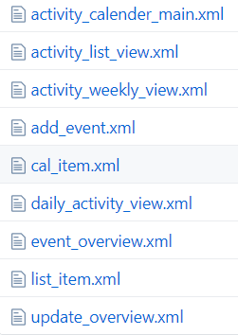
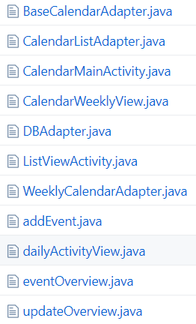

Slide 16
Refactoring (1 min)
Showcase (screenshot) one refactoring you did during implementation
better to show the diff from your GitHub commit history

Slide 17
Testing (1 min)
Showcase (screenshot) test cases you wrote for a method

